Slide 1
ROOT I/O recent improvements
Bottlenecks and Solutions
Rene Brun
December 02 2009

Slide 2
Main Points
ROOT IO basics
Bottlenecks analysis
Solutions

Slide 3
ROOT IO
Basics

Slide 4
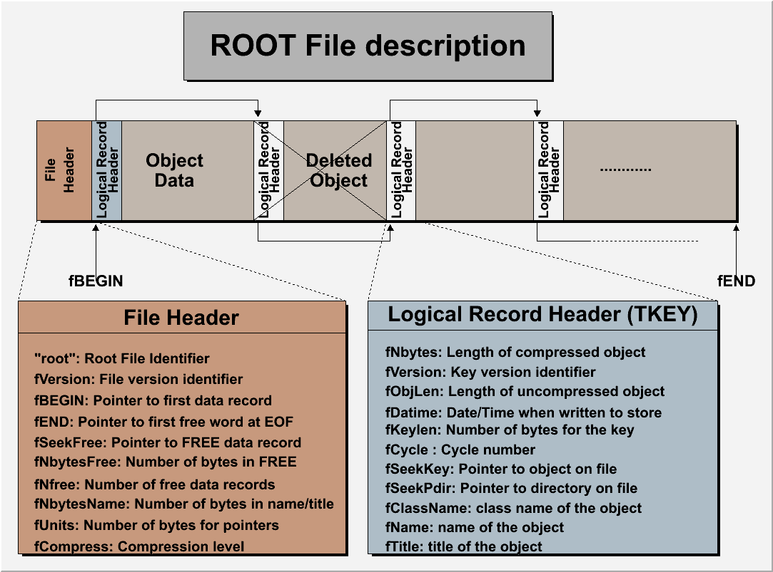
ROOT file structure

Slide 5
TFile::Map
root [0] TFile *falice = TFile::Open("http://root.cern.ch/files/alice_ESDs.root")
root [1] falice->Map()
20070713/195136 At:100 N=120 TFile
20070713/195531 At:220 N=274 TH1D CX = 7.38
20070713/195531 At:494 N=331 TH1D CX = 2.46
20070713/195531 At:825 N=290 TH1D CX = 2.80
….
20070713/195531 At:391047 N=1010 TH1D CX = 3.75
Address = 392057 Nbytes = -889 =====G A P===========
20070713/195519 At:392946 N=2515 TBasket CX = 195.48
20070713/195519 At:395461 N=23141 TBasket CX = 1.31
20070713/195519 At:418602 N=2566 TBasket CX = 10.40
20070713/195520 At:421168 N=2518 TBasket CX = 195.24
20070713/195532 At:423686 N=2515 TBasket CX = 195.48
20070713/195532 At:426201 N=2023 TBasket CX = 15.36
20070713/195532 At:428224 N=2518 TBasket CX = 195.24
20070713/195532 At:430742 N=375281 TTree CX = 4.28
20070713/195532 At:806023 N=43823 TTree CX = 19.84
20070713/195532 At:849846 N=6340 TH2F CX = 100.63
20070713/195532 At:856186 N=951 TH1F CX = 9.02
20070713/195532 At:857137 N=16537 StreamerInfo CX = 3.74
20070713/195532 At:873674 N=1367 KeysList
20070713/195532 At:875041 N=1 END
root [2]
Classes dictionary
List of keys

Slide 6
TFile::ls
root [3] falice->ls()
KEY: TH1D logTRD_backfit;1
KEY: TH1D logTRD_refit;1
KEY: TH1D logTRD_clSearch;1
KEY: TH1D logTRD_X;1
KEY: TH1D logTRD_ncl;1
KEY: TH1D logTRD_nclTrack;1
KEY: TH1D logTRD_minYPos;1
KEY: TH1D logTRD_minYNeg;1
KEY: TH2D logTRD_minD;1
KEY: TH1D logTRD_minZ;1
KEY: TH1D logTRD_deltaX;1
KEY: TH1D logTRD_xCl;1
KEY: TH1D logTRD_clY;1
KEY: TH1D logTRD_clZ;1
KEY: TH1D logTRD_clB;1
KEY: TH1D logTRD_clG;1
KEY: TTree esdTree;1 Tree with ESD objects
KEY: TTree HLTesdTree;1 Tree with HLT ESD objects
KEY: TH2F TOFDig_ClusMap;1
KEY: TH1F TOFDig_NClus;1
KEY: TH1F TOFDig_ClusTime;1
KEY: TH1F TOFDig_ClusToT;1
KEY: TH1F TOFRec_NClusW;1
KEY: TH1F TOFRec_Dist;1
KEY: TH2F TOFDig_SigYVsP;1
KEY: TH2F TOFDig_SigZVsP;1
KEY: TH2F TOFDig_SigYVsPWin;1
KEY: TH2F TOFDig_SigZVsPWin;1
Shows the list of objects
In the current directory
(like in a file system)

Slide 7
Self-describing files
Dictionary for persistent classes written to the file.
ROOT files can be read by foreign readers
Support for Backward and Forward compatibility
Files created in 2001 must be readable in 2015
Classes (data objects) for all objects in a file can be regenerated via TFile::MakeProject
Root >TFile f(“demo.root”);
Root > f.MakeProject(“dir”,”*”,”new++”);

Slide 8
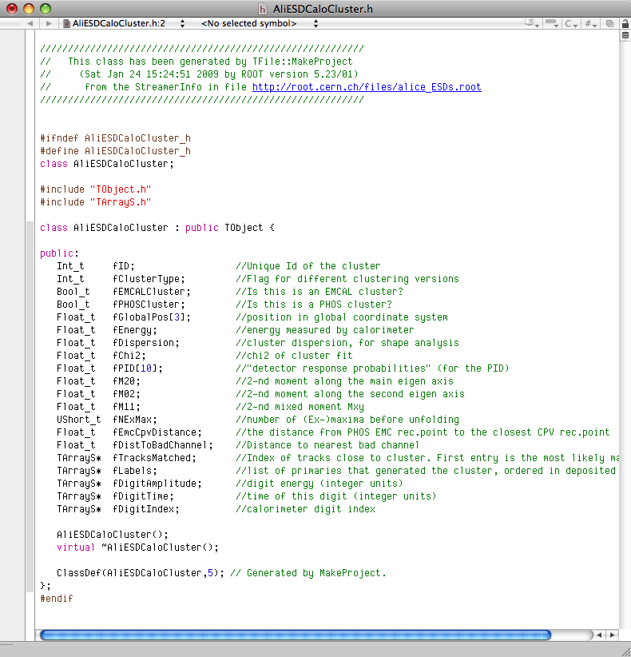
TFile::MakeProject
Generate C++ header files
and shared lib for the classes in file
(macbrun2) [253] root -l
root [0] TFile *falice = TFile::Open("http://root.cern.ch/files/alice_ESDs.root");
root [1] falice->MakeProject("alice","*","++");
MakeProject has generated 26 classes in alice
alice/MAKEP file has been generated
Shared lib alice/alice.so has been generated
Shared lib alice/alice.so has been dynamically linked
root [2] .!ls alice
AliESDCaloCluster.h AliESDZDC.h AliTrackPointArray.h
AliESDCaloTrigger.h AliESDcascade.h AliVertex.h
AliESDEvent.h AliESDfriend.h MAKEP
AliESDFMD.h AliESDfriendTrack.h alice.so
AliESDHeader.h AliESDkink.h aliceLinkDef.h
AliESDMuonTrack.h AliESDtrack.h aliceProjectDict.cxx
AliESDPmdTrack.h AliESDv0.h aliceProjectDict.h
AliESDRun.h AliExternalTrackParam.h aliceProjectHeaders.h
AliESDTZERO.h AliFMDFloatMap.h aliceProjectSource.cxx
AliESDTrdTrack.h AliFMDMap.h aliceProjectSource.o
AliESDVZERO.h AliMultiplicity.h
AliESDVertex.h AliRawDataErrorLog.h
root [3]

Slide 9
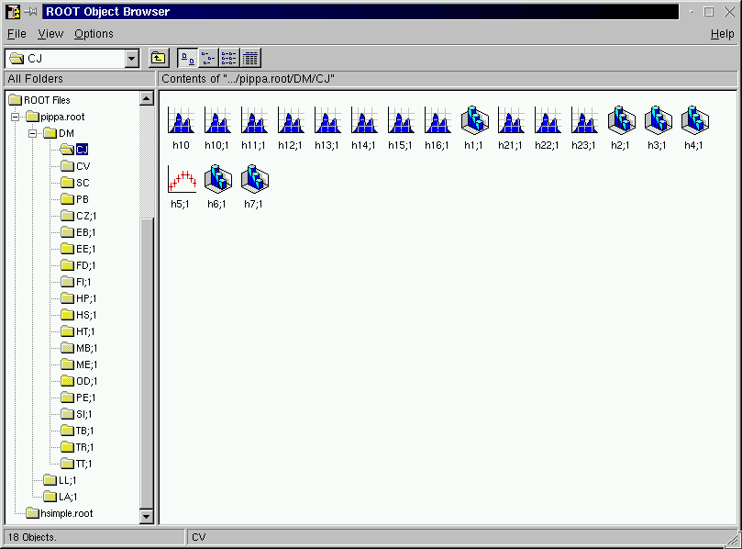

Objects in directory
/pippa/DM/CJ
eg:
/pippa/DM/CJ/h15
A ROOT file pippa.root
with 2 levels of
sub-directories

Slide 10
I/O
Object in Memory
sockets
Net File
Buffer
Web File
http
XML File
XML
Streamer:
No need for
transient / persistent classes
DataBase
SQL
Local
File on
disk

Slide 11
Memory <--> Tree
Each Node is a branch in the Tree
Memory
0
T.GetEntry(6)
1
2
3
4
5
6
7
8
9
10
11
12
13
14
15
16
17
T.Fill()
18
T
tr

Slide 12
ROOT I/O -- Split/Cluster
Tree version
Tree entries
Streamer
Branches
Tree in memory
File

Slide 13
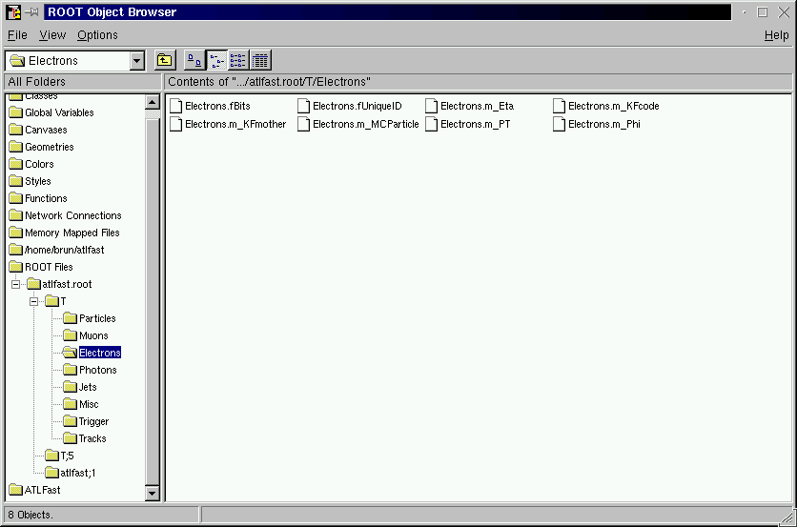
Browsing a TTree with TBrowser
8 leaves of branch
Electrons
A double click
To histogram
The leaf
8 branches of T

Slide 14
Trees Split Mode
Object-wise
Member-wise
streaming

Slide 15
Creating branches
B1: Branches can be created automatically from the natural hierarchy in the top level object.
B2: Branches can be created automatically from a dynamic list of top level objects (recommended).
B3: Branches can be created manually one by one specifying a top level object per top branch.
B4: Sub-branches are automatically created for STL collections and TClonesArray.

Slide 16
Case B1
float a;
int b;
double c[5];
int N;
float* x; //[N]
float* y; //[N]
Class1 c1;
Class2 c2; //!
Class3 *c3;
std::vector<T>;
std::vector<T*>;
TClonesArray *tc;

Slide 17
Case B2
Best solution
Each named member of a TList
Is a top level branch
a
a
a
a
a
a
b
c
d
e

Slide 18





Case B3
Top level branches
Are created manually
a
b
c
d
e

Slide 19
Case B4
Collections
Use split=199 to reduce
The number of branches
In case of polymorphic collections
split = 0
std::vector<T>
split >0
std::vector<T>
split <100
std::vector<T*>
split =199
std::vector<T*>
split >0
TClonesArray

Slide 20
Collections are not equal
Time to read in seconds comp 0 comp 1
***************************************************
TClonesArray(TObjHit) level=99 0.14 0.45
TClonesArray(TObjHit) level= 0 0.17 0.63
vector<THit> level=99 0.32 0.52
vector<THit> level= 0 0.48 0.87
vector<THit> level= 0 MW 0.23 0.65
list<THit> level=99 0.52 0.64
list<THit> level= 0 0.73 0.95
list<THit> level= 0 MW 0.49 0.62
deque<THit> level=99 0.31 0.58
deque<THit> level= 0 0.55 0.93
deque<THit> level= 0 MW 0.36 0.62
set<THit> level=99 0.46 0.81
set<THit> level= 0 0.74 1.06
set<THit> level= 0 MW 0.44 0.69
multiset<THit> level=99 0.46 0.84
multiset<THit> level= 0 0.72 1.06
multiset<THit> level= 0 MW 0.45 0.70
map<THit> level=99 0.45 0.76
map<THit> level= 0 0.97 1.12
map<THit> level= 0 MW 0.84 1.14
Time to read in seconds comp 0 comp 1
***************************************************
multimap<THit> level=99 0.45 0.78
multimap<THit> level= 0 0.89 1.11
multimap<THit> level= 0 MW 0.79 1.12
vector<THit*> level=25599 0.34 0.61
list<THit*> level=25599 0.41 0.81
deque<THit*> level=25599 0.49 0.62
set<THit*> level=25599 0.59 0.76
multiset<THit*> level=25599 0.49 0.73
map<THit*> level=99 1.41 1.55
multimap<THit*> level=99 1.15 1.54
vector<THit*> level=99 (NS) 1.17 1.38
list<THit*> level=99 (NS) 1.33 1.48
deque<THit*> level=99 (NS) 1.36 1.39
set<THit*> level=99 (NS) 1.02 1.48
multiset<THit*> level=99 (NS) 1.28 1.45
For more details run $ROOTSYS/test/bench

Slide 21
ObjectWise/MemberWise Streaming
3 modes to stream
an object
a
b
c
d
a1b1c1d1a2b2c2d2…anbncndn
object-wise to a buffer
member-wise to a buffer
a1a2..anb1b2..bnc1c2..cnd1d2..dn
a1a2…an
each member to a buffer
member-wise gives better compression
b1b2…bn
c1c2…cn
d1d2…dn

Slide 22
More branches is better
10000 is may be too much :☺
Better compression
Faster when reading (in particular a subset of branches)
Good for parallelism (for the future)
Split mode | File size (MBytes) | Comp factor | Write time (seconds) | Read time (seconds)
0 1 branch | 177.45 | 2.23 | 38.7 | 12.6
1 20 branches | 174.7 | 2.26 | 37.9 | 12.0
99 56 branches | 144.9 | 2.53 | 38.3 | 10.8

Slide 23
ROOT IO
Bottlenecks and Solutions

Slide 24
Buffering effects
Branch buffers are not full at the same time.
A branch containing one integer/event and with a buffer size of 32Kbytes will be written to disk every 8000 events, while a branch containing a non-split collection may be written at each event.
This may give serious problems when reading if the file is not read sequentially.

Slide 25
problems
In the past few months we have analyzed Trees from Alice, Atlas, CMS and LHCb and found problems in all cases.
Some of these problems have solutions with old versions of ROOT, eg
  Using effectively the TreeCache
  Optimizing basket buffers
ROOT version 5.25/04 contains several enhancements helping to improve size and performance

Slide 26
Important factors
Objects
in memory
Unzipped buffer
Unzipped buffer
Zipped buffer
Zipped buffer
Zipped buffer
Remote
Disk file
network
Local
Disk file

Slide 27
What is the TreeCache
It groups into one buffer all blocks from the used branches.
The blocks are sorted in ascending order and consecutive blocks merged such that the file is read sequentially.
It reduces typically by a factor 10000 the number of transactions with the disk and in particular the network with servers like xrootd or dCache.
The small blocks in the buffer can be unzipped in parallel on a multi-core machine.
The typical size of the TreeCache is 10 Mbytes, but higher values will always give better results. If you have no memory problem, set large values like 200 Mbytes.

Slide 28
TreeCache: new interface
Facts: Most users did not know if they were using or not the TreeCache.
We decided to implement a simpler interface from TTree itself (no need to know about the class TTreeCache anymore).
Because some users claimed to use the TreeCache and the results clearly showing the contrary, we decided to implement a new IO monitoring class TTreePerfStats.

Slide 29
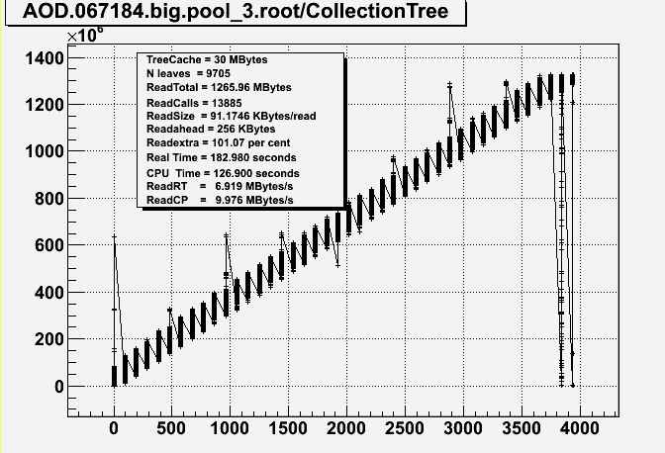
Use TTreePerfStats
void taodr(Int_t cachesize=10000000) {
gSystem->Load("aod/aod"); //shared lib generated with TFile::MakeProject
TFile *f = TFile::Open("AOD.067184.big.pool.root");
TTree *T = (TTree*)f->Get("CollectionTree");
Long64_t nentries = T->GetEntries();
T->SetCacheSize(cachesize);
T->AddBranchToCache("*",kTRUE);
TTreePerfStats ps("ioperf",T);
for (Long64_t i=0;i<nentries;i++) {
T->GetEntry(i);
}
ps.SaveAs("aodperf.root");
}
Root > TFile f(“aodperf.root”)
Root > ioperf.Draw()

Slide 30
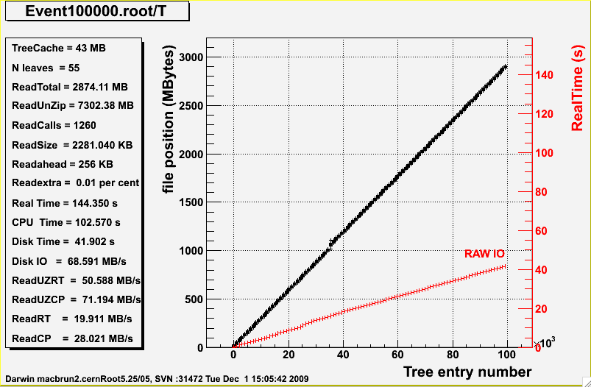
Performance with standard ROOT example

Slide 31
Test conditions
Because both the TreeCache and Readahead are designed to minimize the difference RealTime-CpuTime, care has been taken to run the tests with “cold” files, making sure that system buffers were dropped before running a new test.
Note that increasing the TreeCache size reduces also the CpuTime.
Note that running OptimizeBaskets also reduces substantially the CpuTime because the number of baskets is in general reduced by several factors.

Slide 32
Test conditions 2
Using one of the AOD files the class headers have been generated automatically via TTree::MakeProject.
The corresponding shared library is linked such that the same object model is used in my tests and in Atlas persistent model.
The tests read systematically all entries in all branches. Separate tests have been run to check that the optimal performance is still obtained when reading either a subset of branches, a subset of entries or both. This is an important remark because we have seen that sometimes proposed solutions are good when reading everything and very bad in the other mentioned use cases that are typical of the physics analysis scenarios.

Slide 33
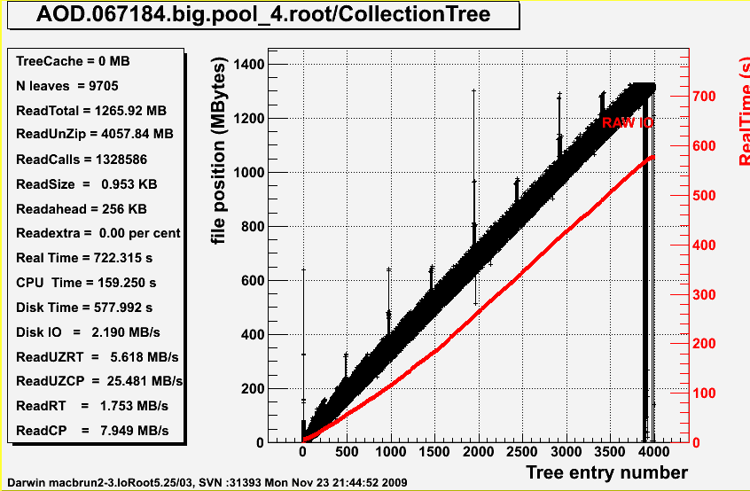
See Doctor

Slide 34
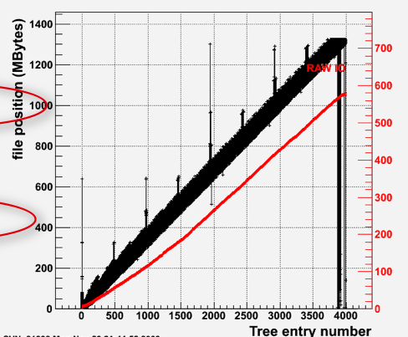
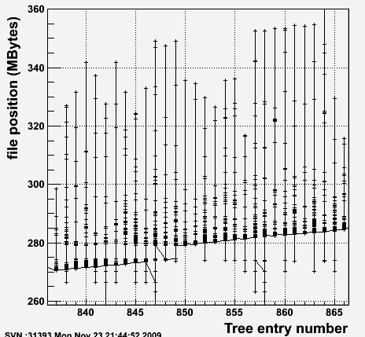
Overlapping reads
100 MBytes

Slide 35
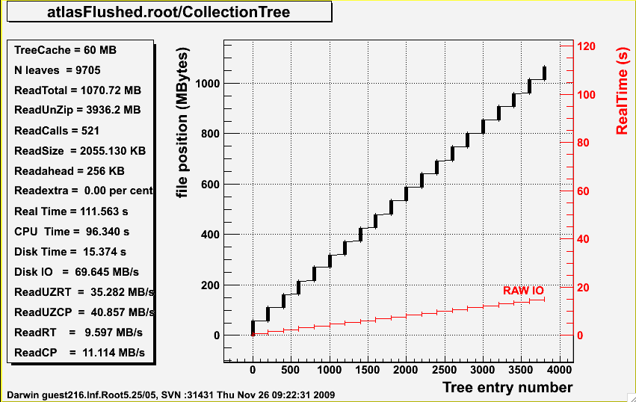
After doctor
gain a factor 6.5 !!
Old Real Time = 722s
New Real Time = 111s
The limitation is now cpu time

Slide 36
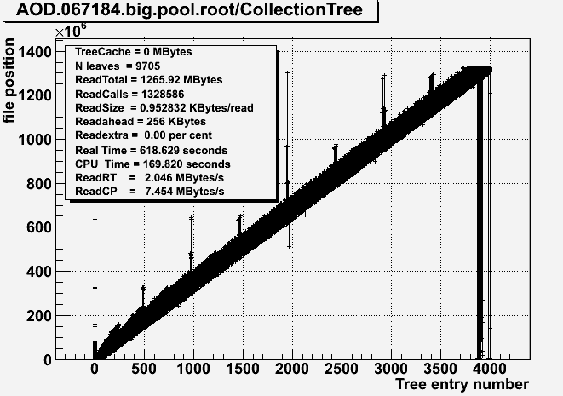
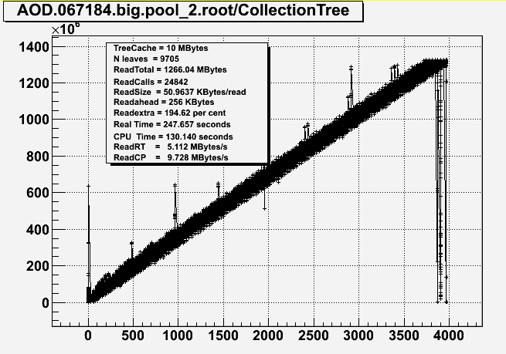
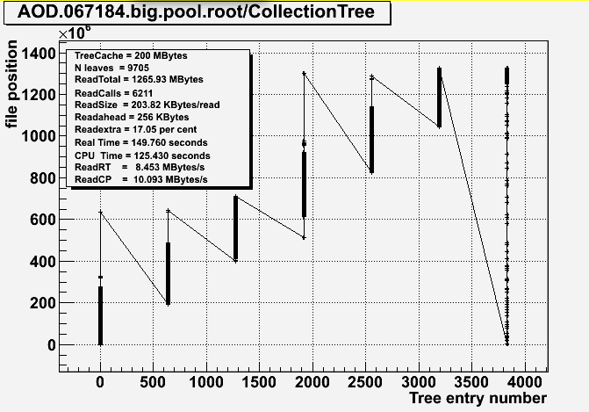
TreeCache size impact
0
10
200
30

Slide 37
TreeCache results table
Original Atlas file (1266MB), 9705 branches split=99
Cache size (MB) | readcalls | RT pcbrun4 (s) | CP pcbrun4 (s) | RT macbrun (s) | CP macbrun (s)
0 | 1328586 | 734.6 | 270.5 | 618.6 | 169.8
LAN 1ms 0 | 1328586 | 734.6+1300 | 270.5 | 618.6+1300 | 169.8
10 | 24842 | 298.5 | 228.5 | 229.7 | 130.1
30 | 13885 | 272.1 | 215.9 | 183.0 | 126.9
200 | 6211 | 217.2 | 191.5 | 149.8 | 125.4
Reclust: OptimizeBaskets 30 MB (1147 MB), 203 branches split=0
Cache size (MB) | readcalls | RT pcbrun4 (s) | CP pcbrun4 (s) | RT macbrun (s) | CP macbrun (s)
0 | 15869 | 148.1 | 141.4 | 81.6 | 80.7
LAN 1ms 0 | 15869 | 148.1 + 16 | 141.4 | 81.6 + 16 | 80.7
10 | 714 | 157.9 | 142.4 | 93.4 | 82.5
30 | 600 | 165.7 | 148.8 | 97.0 | 82.5
200 | 552 | 154.0 | 137.6 | 98.1 | 82.0
Reclust: OptimizeBaskets 30 MB (1086 MB), 9705 branches split=99
Cache size (MB) | readcalls | RT pcbrun4 (s) | CP pcbrun4 (s) | RT macbrun (s) | CP macbrun (s)
0 | 515350 | 381.8 | 216.3 | 326.2 | 127.0
LAN 1ms 0 | 515350 | 381.8 + 515 | 216.3 | 326.2 +515 | 127.0
10 | 15595 | 234.0 | 185.6 | 175.0 | 106.2
30 | 8717 | 216.5 | 182.6 | 144.4 | 104.5
200 | 2096 | 182.5 | 163.3 | 122.3 | 103.4

Slide 38
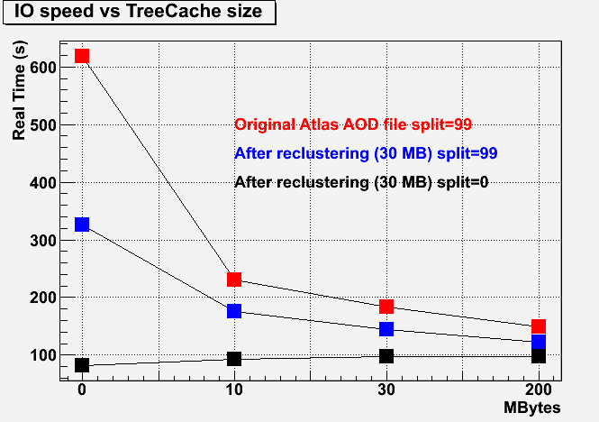
TreeCache results graph

Slide 39
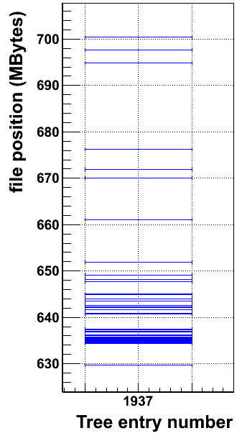
What is the readahead cache
The readahead cache will read all non consecutive blocks that are in the range of the cache.
It minimizes the number of disk access. This operation could in principle be done by the OS, but the fact is that the OS parameters are not tuned for many small reads, in particular when many jobs read concurrently from the same disk.
When using large values for the TreeCache or when the baskets are well sorted by entry, the readahead cache is not necessary.
Typical (default value) is 256 Kbytes, although 2 Mbytes seems to give better results on Atlas files, but not with CMS or Alice.

Slide 40
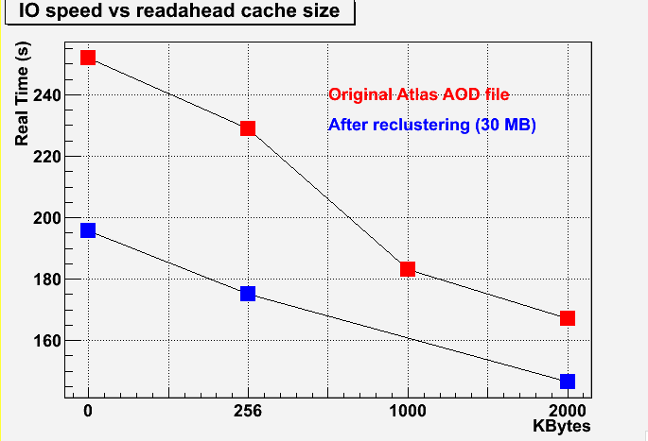
Readahead reading all branches, all entries
Read ahead
excellent

Slide 41
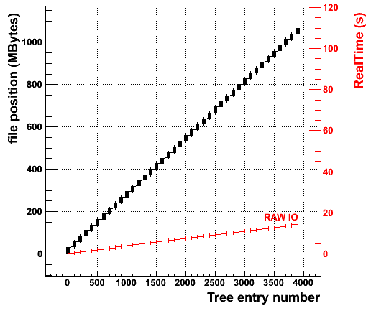
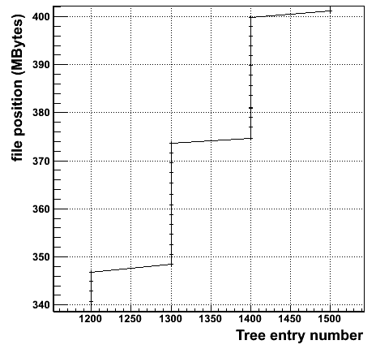
OptimizeBaskets, AutoFlush
Solution, enabled by default:
  Tweak basket size!
  Flush baskets at regular intervals!
New in v5.25/04!

Slide 42
OptimizeBaskets
Facts: Users do not tune the branch buffer size
Effect: branches for the same event are scattered in the file.
TTree::OptimizeBaskets is a new function that will optimize the buffer sizes taking into account the population in each branch.
You can call this function on an existing read only Tree file to see the diagnostics.

Slide 43
FlushBaskets
TTree::FlushBaskets was introduced in 5.22 but called only once at the end of the filling process to disconnect the buffers from the tree header.
In version 5.25/04 this function is called automatically when a reasonable amount of data (default is 30 Mbytes) has been written to the file.
The frequency to call TTree::FlushBaskets can be changed by calling TTree::SetAutoFlush.
The first time that FlushBaskets is called, we also call OptimizeBaskets.

Slide 44
FlushBaskets 2
The frequency at which FlushBaskets is called is saved in the Tree (new member fAutoFlush).
This very important parameter is used when reading to compute the best value for the TreeCache.
The TreeCache is set to a multiple of fAutoFlush.
Thanks to FlushBaskets there is no backward seeks on the file for files written with 5.25/04. This makes a dramatic improvement in the raw disk IO speed.

Slide 45
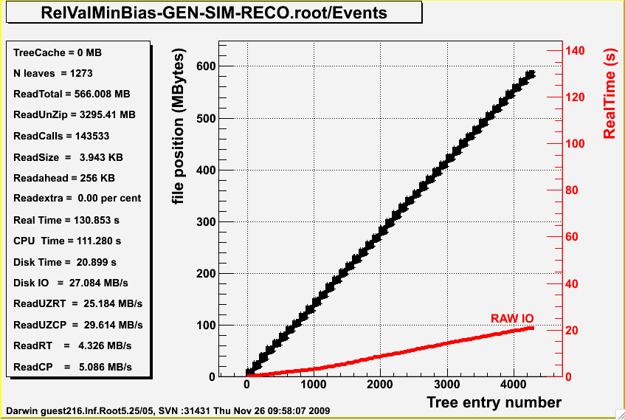
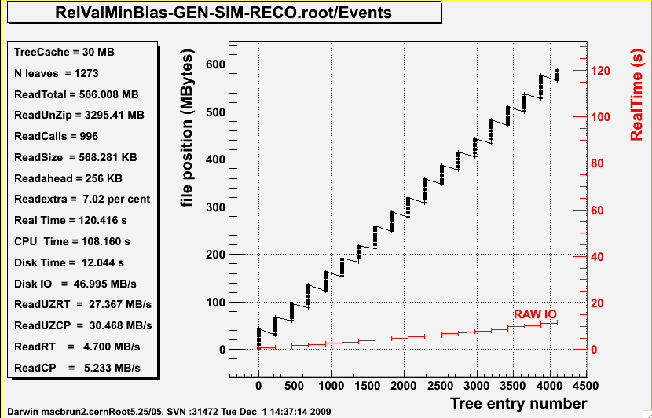
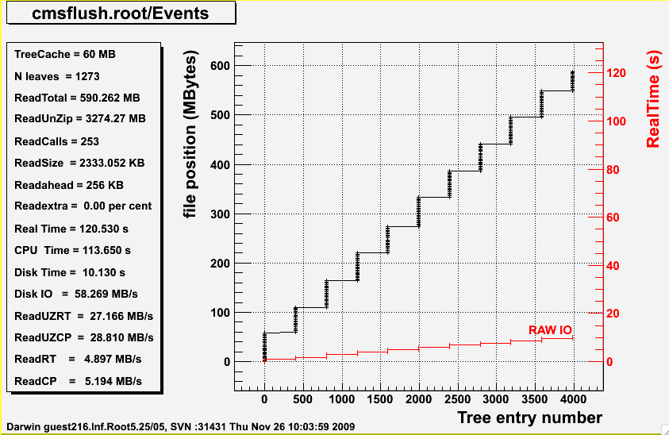
Similar pattern with CMS files
CMS : mainly CPU problem
due to a complex object model

Slide 46
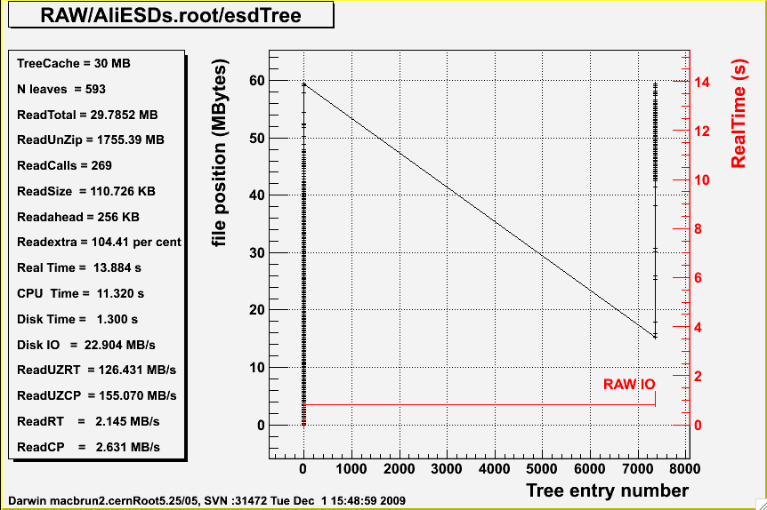
Alice files
Only small files used in the test.
Performance improvement with 5.26

Slide 47
LHCb files
Performance must be very poor !!
One LHCb file contains about 45 Trees !!
Each Tree should be a top level branch in the main Tree
  To take advantage of the TreeCache
  To take advantage of FlushBaskets

Slide 48
TreeCache
Interface for
Different use patterns

Slide 49
Use Case 1
Reading all branches
void taodr(Int_t cachesize=10000000) {
TFile *f = TFile::Open("AOD.067184.big.pool.root");
TTree *T = (TTree*)f->Get("CollectionTree");
Long64_t nentries = T->GetEntries();
T->SetCacheSize(cachesize);
T->AddBranchToCache("*",kTRUE);
for (Long64_t i=0;i<nentries;i++) {
T->GetEntry(i);
}
}

Slide 50
Use Case 2
Reading only a few branches in consecutive events
void taodr(Int_t cachesize=10000000) {
TFile *f = TFile::Open("AOD.067184.big.pool.root");
TTree *T = (TTree*)f->Get("CollectionTree");
Long64_t nentries=1000;
Long64_t efirst= 2000;
Long64_t elast = efirst+nentries;
T->SetCacheSize(cachesize);
T->SetCacheEntryRange(efirst,elast);
TBranch *b_m_trigger_info = T->GetBranch("m_trigger_info");
TBranch *b_m_compactData = T->GetBranch("m_compactData");
T->AddBranchToCache(b_m_trigger_info,kTRUE);
T->AddBranchToCache(b_m_compactData, kTRUE);
T->StopCacheLearningPhase();
for (Long64_t i=0;i<nentries;i++) {
T->LoadTree(i);
b_m_trigger_info->GetEntry(i);
b_m_compactData->GetEntry(i);
}
}

Slide 51
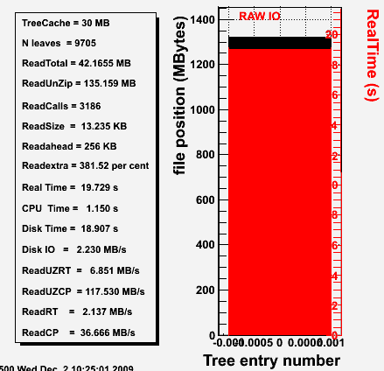
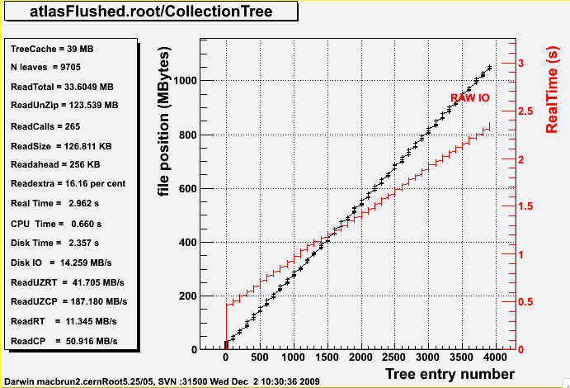
Use Case 2 results reading 33 Mbytes out of 1100 MBytes
Seek time = 3186*5ms = 15.9s
Seek time = 265*5ms = 1.3s
Old ATLAS file
New ATLAS file

Slide 52
Use Case 3
Select events with one branch then read more branches
void taodr(Int_t cachesize=10000000) {
TFile *f = TFile::Open("AOD.067184.big.pool.root");
TTree *T = (TTree*)f->Get("CollectionTree");
Long64_t nentries=1000;
Long64_t efirst= 2000;
Long64_t elast = efirst+nentries;
T->SetCacheSize(cachesize);
T->SetCacheEntryRange(efirst,elast);
T->SetCacheLearnEntries(10);
TBranch *b_m_trigger_info = T->GetBranch("m_trigger_info");
T->AddBranchToCache(b_m_trigger_info,kTRUE);
for (Long64_t i=0;i<nentries;i++) {
T->LoadTree(i);
b_m_trigger_info->GetEntry(i);
if (somecondition) readmorebranches();
}
}
All branches used in the first 10 entries will be cached

Slide 53
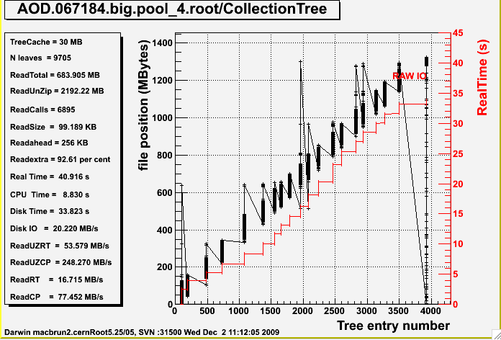

Use Case 3 results reading 1% of the events
Even in this difficult case cache is better

Slide 54
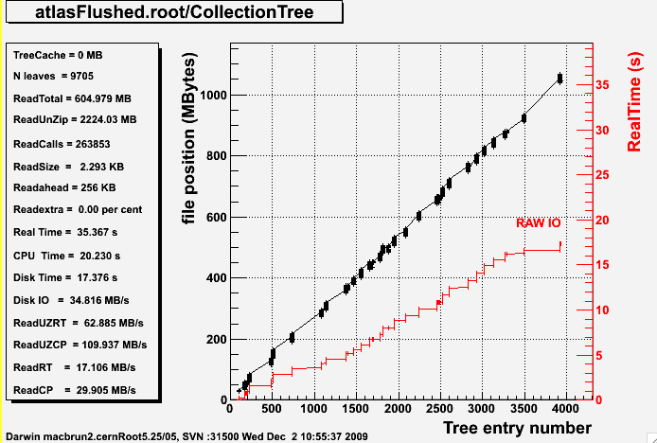
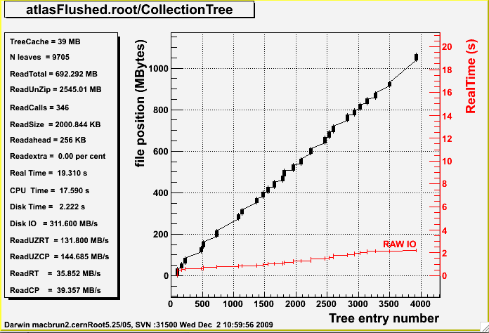
Use Case 3 results reading 1% of the events
Even in this difficult case cache is better

Slide 55
Reading network files
Same results with xrootd
f = TFile::Open("http://root.cern.ch/files/AOD.067184.big.pool_4.root")
f = TFile::Open("http://root.cern.ch/files/atlasFlushed.root")
File type Cache on/off | Local file | LAN =0.3ms 1 Gbit/s | WLAN = 3ms 100 Mbits/s | ADSL=72ms 8 Mbits/s
Atlas orig CA=OFF | RT=720s TR=1328587 | RT=1156s NT=400+12s | RT=4723s NT=4000+120s | RT > 2 days NT>2 days
Atlas orig CA=ON | RT=132s TR=323 | RT=144s NT=0.1+12s | RT=253s NT=1+120s | RT=1575s NT=223+1200s
Atlas flushed CA=OFF | RT=354s TR=486931 | RT=485s NT=120+11s | RT=1684 NT=1200+110s | RT= NT>1 day
Atlas flushed CA=ON | RT=106s TR=45 | RT=117s NT=0.03+11s | RT=217s NT=0.1+110s | RT=1231s NT=25+1100s
TR=Transactions
NT=Network Time (latency + data transfer)

Slide 56
Important factors
Ideas to improve cpu time
Objects
in memory
Parallel unzip
Implemented in 5.25/04
Unzipped buffer
Unzipped buffer
Zipped buffer
Zipped buffer
Zipped buffer
Remote
Disk file
network
Local
Disk file

Slide 57
Summary
Use of the TreeCache is essential, even with local files
Flushing buffers at regular intervals help a lot
In ROOT 5.25/04, FlushBaskets is ON by default and also an automatic basket buffer optimization.
In ROOT 5.25/04 a simplified interface to TreeCache is provided via TTree.
Files written with 5.25/04 will be faster to read

Slide 58
Summary 2
Version 5.26 will be released on December 15.
This version is back compatible with 5.22 and 5.24.
We hope that collaborations will move soon to this new version.

